Slide 1
Pokemon: Got to Win it All
Shaun Whitsel

Slide 2
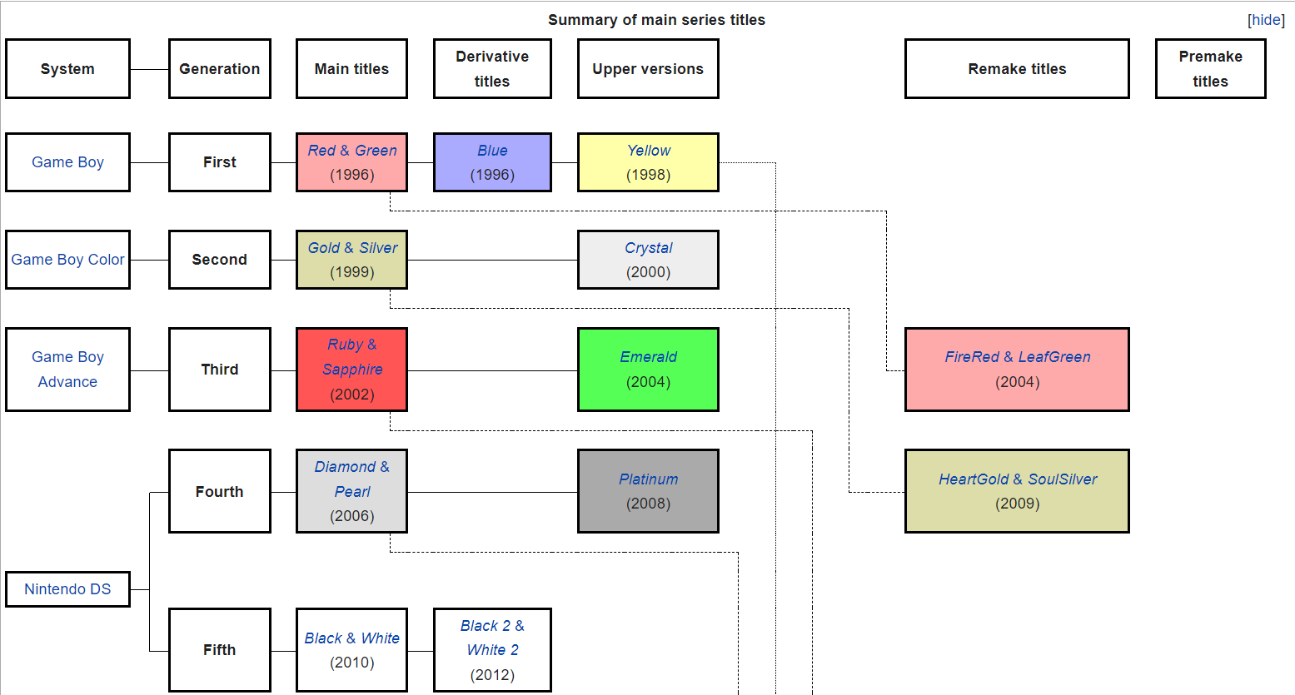

Slide 3
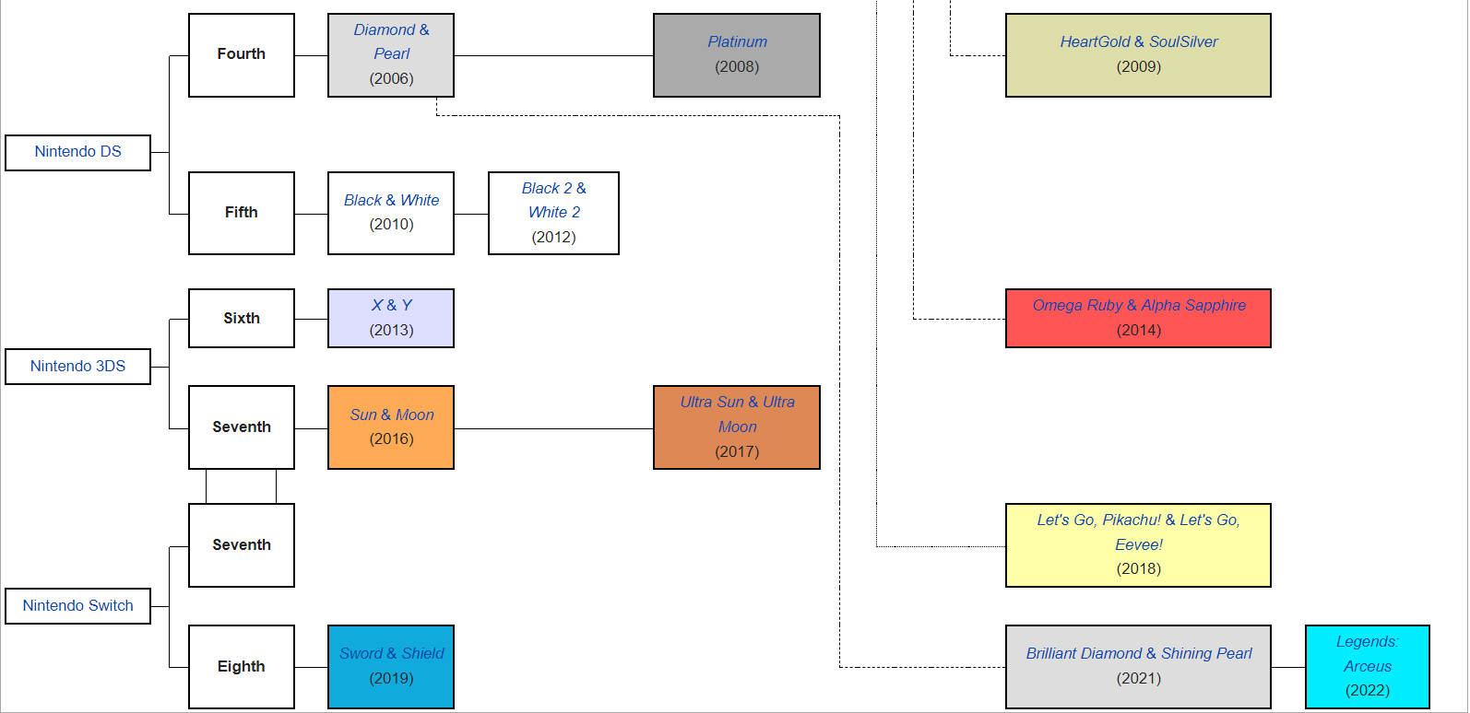

Slide 4
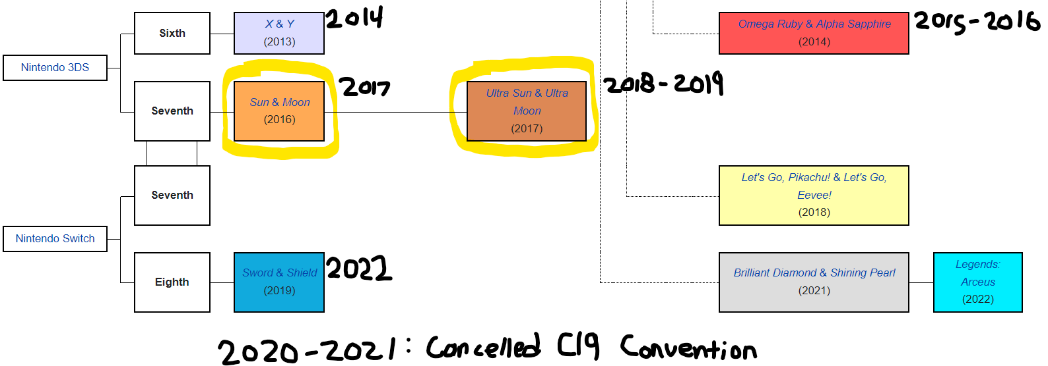

Slide 5
Questions to be Asked
Which is the most effective team?
Were these Pokemon used in the tournament?
Did these Pokemon survive through the years?

Slide 6
Things to Concentrate On
Only Top finishers for each year 2017-2019 or we’ll be here all month long. I kind of want to spend time with family for the holidays.
Only using Masters Division ( Anyone 16 years or over)
- Other Division include Juniors (0-11), Seniors (12-15), and other game types (Card, Pokemon Go, Pokken Fighting game)
Decided to stay with 7th gen due to ease of translation between the games (XY is different to Ruby Sapphire remakes compared to Sun/Moon and USun/ UMoon)

Slide 7
Forget about it!
Don’t care about qualifying for the tournament with regionals. Too many points and rules. Let’s just say you paid off a couple to people to be placed in the top 4 in the Master’s Division. You’re older than 15 years old right?
Win ratio. Let’s say you have only one match to see best team/best player.
Held Items, moves, and Natures

Slide 8
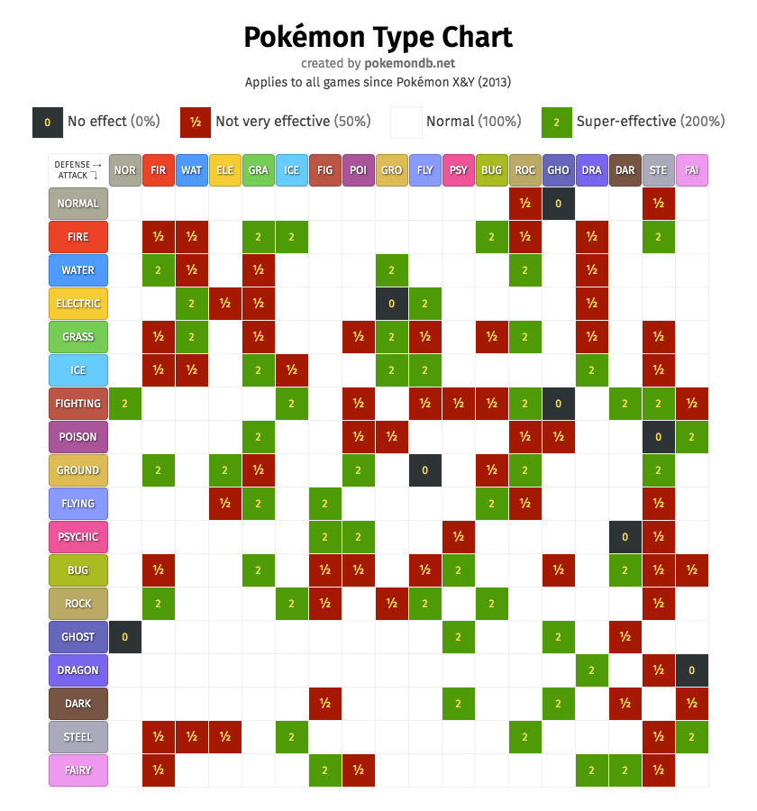

Slide 9






Predictions
Tapu Koko (Electric/Fairy)
Incineroar (Fire/Dark)
Kartana (Grass/Steel)
Salamence (Dragon/Flying)
Snorlax (Normal)
Tapu Fini (Water/Fairy)

Slide 10
Stats and Types
Tapu Koko
Incineroar
Kartana
Salamence
Snorlax
Tapu Fini

Slide 11
Stat Ranks
Pokemon | HP | Attack | Defense | Special Attack | Special Defense | Speed | Total
Tapu Koko | 156th | 52nd | 95th | 80th | 152nd | 3rd | 18th
Incineroar | 47th | 49th | 79th | 122nd | 86th | 222nd | 44th
Kartana | 250th | 1st | 14th | 239th | 381st | 28th | 19th
Salamence | 57th | 9th | 117th | 40th | 122nd | 46th | 10th
Snorlax | 6th | 62nd | 206th | 191st | 31st | 369th | 34th
Tapu Fini | 144th | 189th | 28th | 74th | 15th | 103rd | 17th

Slide 12
2019 Champion Stat Ranks
Pokemon | HP | Attack | Defense | Special Attack | Special Defense | Speed | Total
Lunala | 10th | 54th | 91st | 4th | 36th | 52nd | 1st
Groudon | 30th | 3rd | 9th | 58th | 87th | 82nd | 3rd
Incineroar | 47th | 49th | 79th | 122nd | 86th | 222nd | 44th
Salamence | 57th | 9th | 117th | 40th | 122nd | 46th | 10th
Tapu Fini | 144th | 189th | 28th | 74th | 15th | 103rd | 17th
Stakataka | 220th | 15th | 1st | 266th | 43rd | 396th | 13th

Slide 13



2019 Champion Team
Lunala
Groudon
Incineroar
Salamence
Tapu Fini
Stakataka

Slide 14
How is this Business Related?
Let’s go to Vegas and put stock in Fanduel*. Bid for Pokeman results.**
If you can pay $10 for a masterclass for a movie named Moneyball where Baseball player data can make a successful team, then we can make a 2022 movie about a non-Pokemon fan winning the highest tournament for Pokemon.
The prize money is $500,000 so you can use that money to help your private business or invest in Bitcoin ☺
I DO NOT CONDONE GAMBLING IN ANY CAPACITY unless you are 21+, aware of potential losses and play responsibly (no credit/savings/retirement usage)
*Not being Sponsored by Fanduel. Or Pokemon for that matter. ☺
**2.4.1 Prohibitions- Wagering or gambling on the results of a game, portion of a game, match, or number or matches. ☹ Source: Pokemon.com

Slide 15
Limitations on Analyzing this Data
If had more time, would I be able to add more contestants with their team? Add typing too.
There is an element of randomness (scale of hp lowering attacks, chances of missing an attack)
Additions of moves and passive traits does make this more difficult to answer the question asked before.
If I had more time, I could have created my own (but it already exists) a program that simulates different stats, traits, attack effectiveness, and types)
TOO MANY TYPES (Fairy, and Dragon, and Steel Oh my!!)
New rules in the future

Slide 16
Limitations on Analyzing this Data Pt.2
Was I speaking a foreign language??
Did I get through to you?
Too confusing?
You probably don’t care to compete.
Pokeman is for kids… I got a house rent to pay and kids to feed.
Terms used can be confusing for even veteran Pokemon player.
After a few years, some data sets can be outdated due to new Metagame.

Slide 17
Concluding Analysis
The most successful team is subjective due to interests, bias, randomness, and strategy.
The Pokemon Listed were never used together but were the most used overall between 2017-2019.
Will these Pokemon remain successful in Sword and Shield (2022)?

